Slide 1
MEC 510 Project
On the extension of a Fourier Descriptor Based
Method for Planar Four-Bar Linkage Synthesis
for Generation of Open and Closed Paths
Joshua Romero 106226795
Michael Lotti 107931636

Slide 2
Problem
To use a reduction in design variable space to more efficiently synthesize
a four-bar linkage mechanism through Fourier Transforms. At the beginning of the
program, the user must input a set of points. Afterwards, a Discrete Fourier Function
is used to convert the set of points into an approximated curve (page 1). Finally, a
numerical search is performed to find the optimal values of the design variables in the
reduced set (pages 5 and 4 respectively). These values are obtained from the reduced
set of design variables through a set of known relations found on, again, pages 4 and 5.

Slide 3
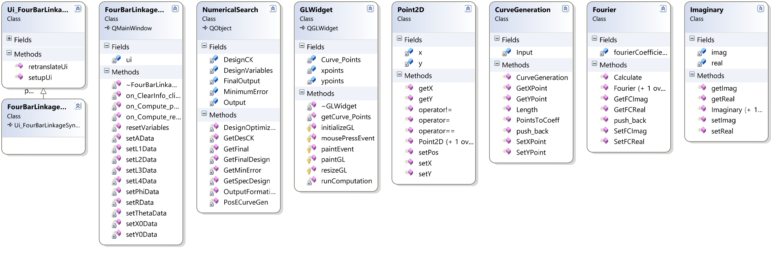
Class diagram

Slide 4
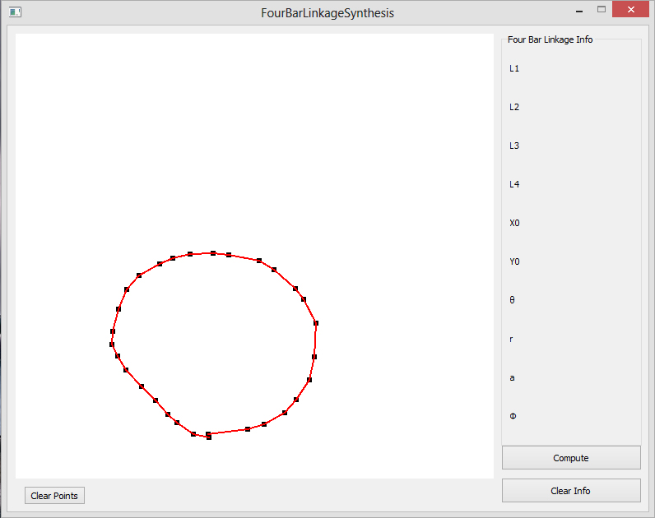
GUI Design
The user can create a curve for the synthesis process by clicking the curve shape in the Open GL widget.
The user curve can be cleared by pressing the clear points button. This will clear the points vector.
Pressing the compute button after the user defined curve is complete will start the synthesis algorithm.
Once the program is complete the four bar linkage information section will be populated with the applicable values found from the algorithm.
Using the clear info button will wipe out the Four Bar Linkage data to allow for another run.

Slide 5
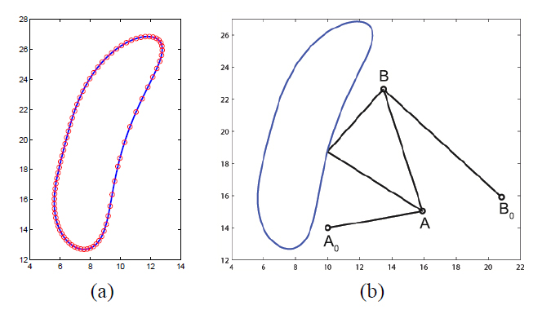
Example
A user supplies a predefined curve as shown in (a) blue line.
Our task path function will then approximate the curve by using a Fourier series. This is shown by the pink circles shown in (a).
Using the least squares or the loop closure methods we will obtain the link lengths.
These lengths will then be tested against to make sure they satisfy the link ratios as well as the feasibility test.
If this is achieved we will compute the Fourier coefficients and evaluate the error function for the lowest amount of error.
Once the error has been minimized we recover the remaining design variables needed to synthesize the four bar linkage.
Following the aforementioned Fourier synthesis algorithm the four bar linkage is derived, this can be seen in (b).
[Four-Bar Linkage Synthesis for Generation of Open and Closed Paths, Ge, Pg.6]

